Slide 1
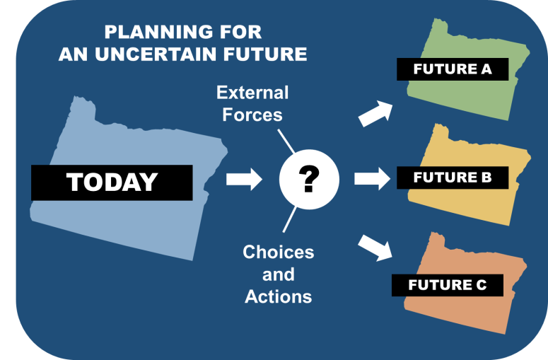
Scenario Planning with VisionEval in Oregon
Notes:
VisionEval is intended to inform long-range planning efforts and is used to test the tradeoffs of alternative future actions and uncertain trends across a range of outcomes. VisionEval has allowed ODOT to analyze trends within key categories of statewide and regional importance, including mobility, environment, and costs. The tools allows us to explore a number of potential future outcomes based on various types of investment actions and policy choices.

Slide 2

ODOT’s S-T-O-RM Analysis Toolkit
Strategic
("What would it take?")
Tactical
("How?")
Operational
(Details)
Strategic Models can help with long-term visioning/ policymaking/funding/resilience analysis, but sacrifice detail.
What would
it take?
How?
Details?
Reporting & Monitoring
(Meeting expectations?)
Tactical Models use fixed assumptions (e.g. a single economy, fixed fuel prices) to work out how to best implement allotted funding.
Meeting
Expectations?
Reporting & Monitoring should reflect observed behavior
(not modeled)
Operational Models help with short-term implementation details (e.g. signal timing).
Notes:
VisionEval is a strategic tool that ODOT uses for exploring long range changes to policies and investments. It fits into the top portion of ODOT’s analysis ‘funnel’ of Strategic, Tactical, Operational, and Reporting and Monitoring tools. VisionEval is the high level strategic tool to give direction for analysis at the more detailed levels.
ODOT utilizes VisionEval to conduct long range scenario planning activities at the statewide and local levels.

Slide 3
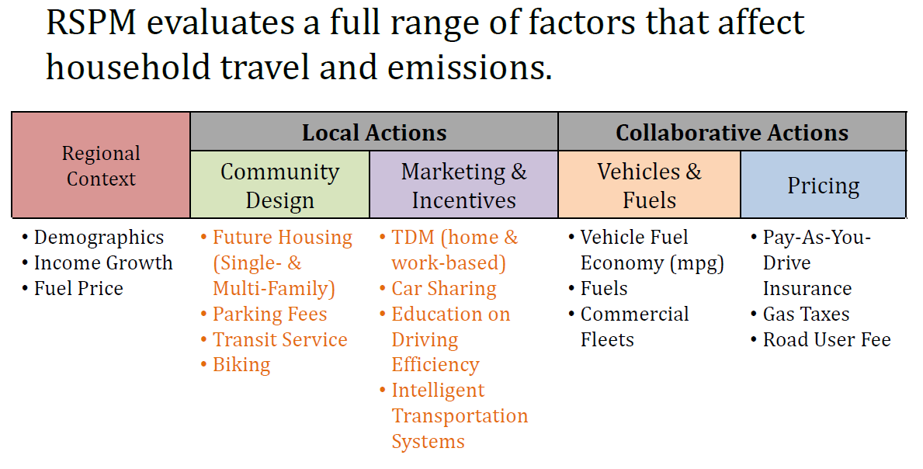
VisionEval Model Inputs
Local Level
  Community Design (Land Use)
  Local Transportation Actions
State Level
  Collaborative & State-led Actions
  Regional Context variables
Notes:
This graphic shows how ODOT classifies the local and state level VisionEval inputs into groups for communication purposes; regional context, local actions, and collaborative or state-lead actions.
ODOT supports a scenario planning at the local level called the Strategic Assessment process. Strategic Assessments are a robust analytical process to inform public officials, staff, and stakeholders on key issues and the policy implications tied to local and regional goals. The results of a Strategic Assessment can help answer questions, such as:
• Given our current plans and trends, are we achieving the long term outcomes we want to see?
• What potential actions could we pursue to better meet our goals?
• How can we use analysis to frame a strategic discussion around the tradeoffs and preferences of our long term policy actions and resilience/risk to future uncertainties?
Strategic Assessments are intended to inform regional, long-range planning efforts and are used to test the tradeoffs of alternative futures actions and uncertain trends across a range of outcomes.

Slide 4
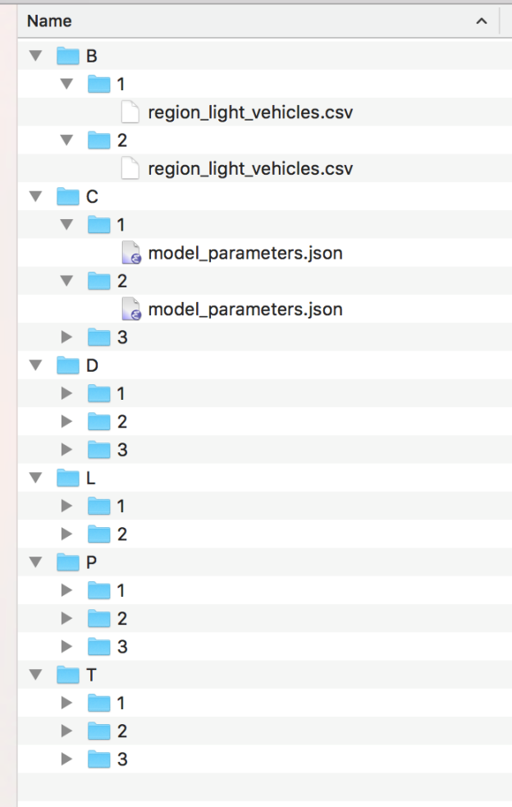
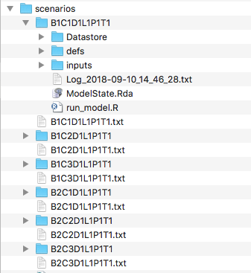

VisionEval Multi-run process input set-up output scenarios
Bicycle diversion
Travel Costs
Demand management
Land Use
Bicycle diversion Level2
All others Level 1
Parking
Transit
Notes:
Strategic Assessments and Scenario Planning start by working with stakeholders to determine the inputs and assumptions for modeling the adopted plans and future trends. Once this reference scenario has been run, a number of inputs are altered using a process called sensitivity testing. Sensitivity tests are ‘what if’ analyses to help planners understand the relative effect of changes to policy, investments, and programs.
A key value for ODOT with the tool has been to quickly evaluate many alternate scenarios or sensitivity tests, investigate the impact of various combinations of more or less ambitious policies, and test policy decisions for resilience under future conditions (such as changes to fuel price, income, or population growth).
This graphic demonstrates the VisionEval multirun process that allows users to quickly build and test thousands of ‘scenario’ runs to achieve the desired level of analysis. The input folders on the left comprise the various scenarios being tested, and the outputs on the right represent model results from all the possible combinations of inputs. These outputs can then be transferred to a summary spreadsheet for metrics, reporting, and visualization.

Slide 5
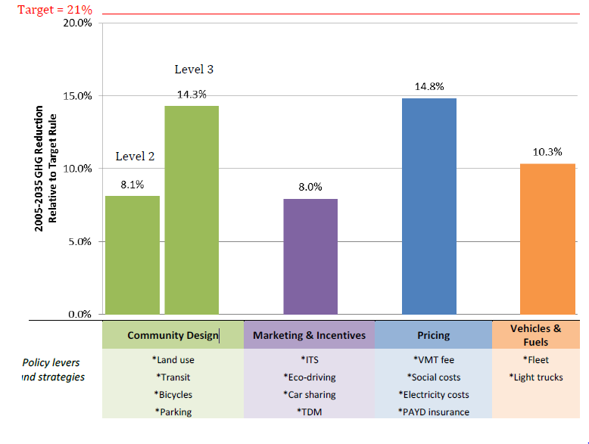
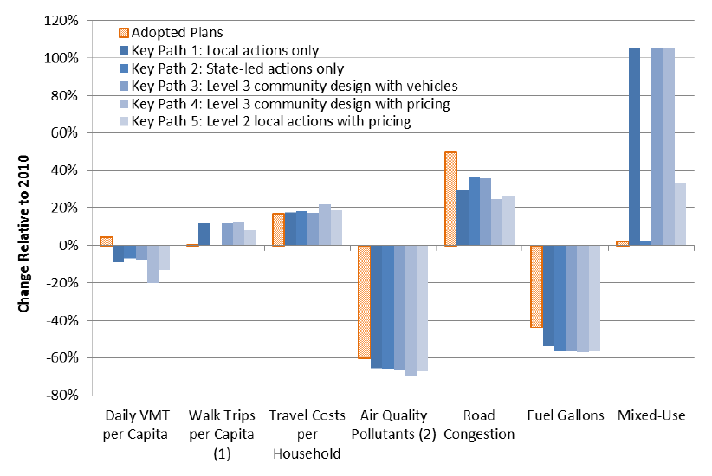
Outputs - MPO Level Analysis
Target 21%
RSPM Inputs:
Adopted Plans
Notes:
After testing is completed, out puts can be displayed in a number of methods to meet the needs of the participants. This graphic show how far different types of policy and investment actions came to achieving the MPO GHG reduction target when compared to the baseline of adopted plans. And this graphic shows how sensitivity testing is used to illustrate the relative change from adopted plans of various key paths (or groups of investment actions) on individual outputs, ie DVMT, walk trips, household travel costs, congestion, etc.
Local Benefits of Strategic Assessment and Scenario Planning with VisionEval
More comprehensive than traditional tools
Quantifies local plans across a broad spectrum of policies and outcomes
Shows the trade offs between policy choices
Demonstrates the resilience of adopted plans to future uncertainties such as fuel price and population growth

Slide 6
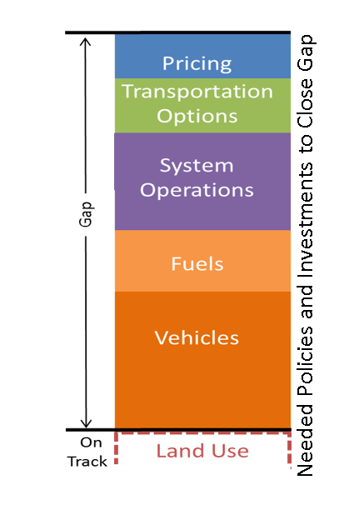
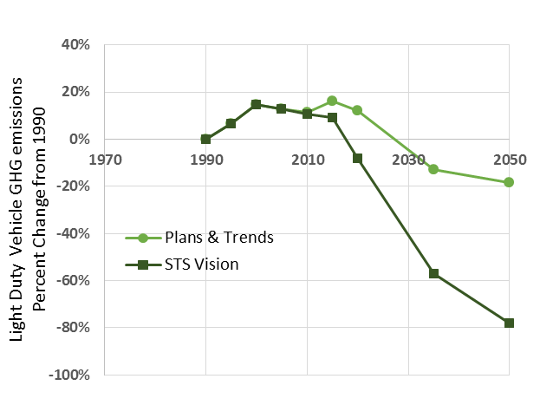
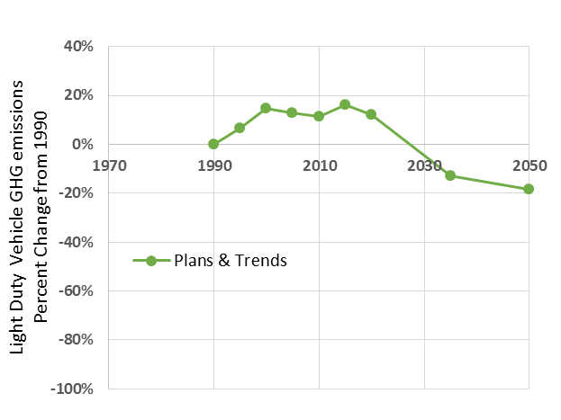
Outputs – Statewide Vision & Goals
Potential range
Notes:
Shows gaps between adopted plans and state ghg reduction goal, and sensitivity testing shows the range of that gap under different types of investments and policy choices. From these sensitivity testing scenarios, groups of policy and investment actions can be identified that bring us closer to achieving the goal.
State benefits of scenario planning with VisionEval:
Inform future state actions such as policies that will help meet state and local goals and requirements
Identified further areas of collaboration between state agencies, MPOs, and local government

Slide 7
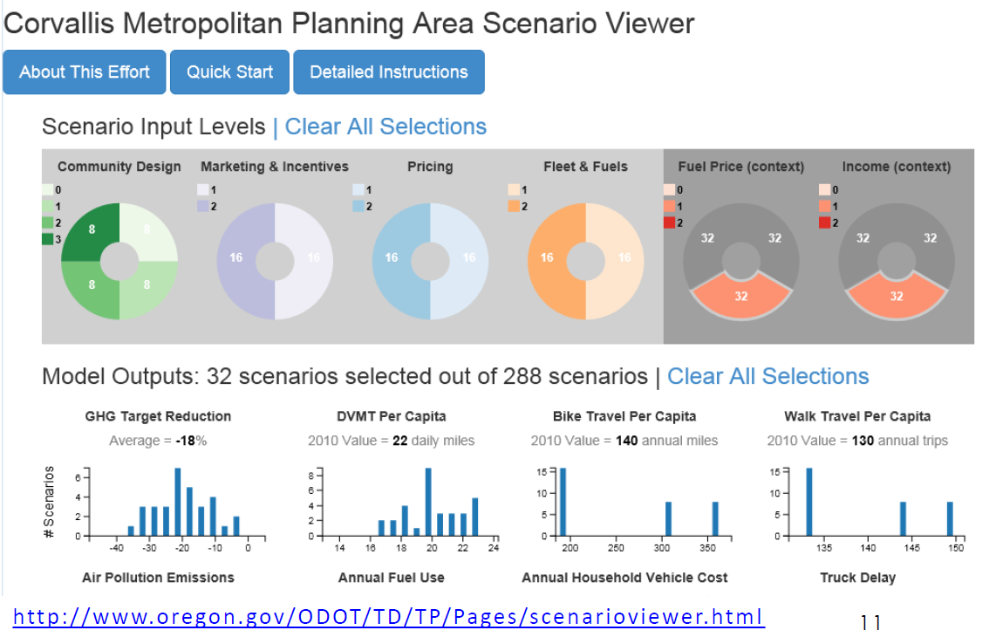

Outputs – Scenario Viewer
Notes:
Once an assessment is completed, participants have access to various products, including data, maps, a web-based interactive Scenario Viewer tool, and additional information on the base year and future year reference scenarios, sensitivity tests, and key path preferences.
This is a good way for analysts and engineers to explore & validate the hundreds of scenarios that were run.

Slide 8

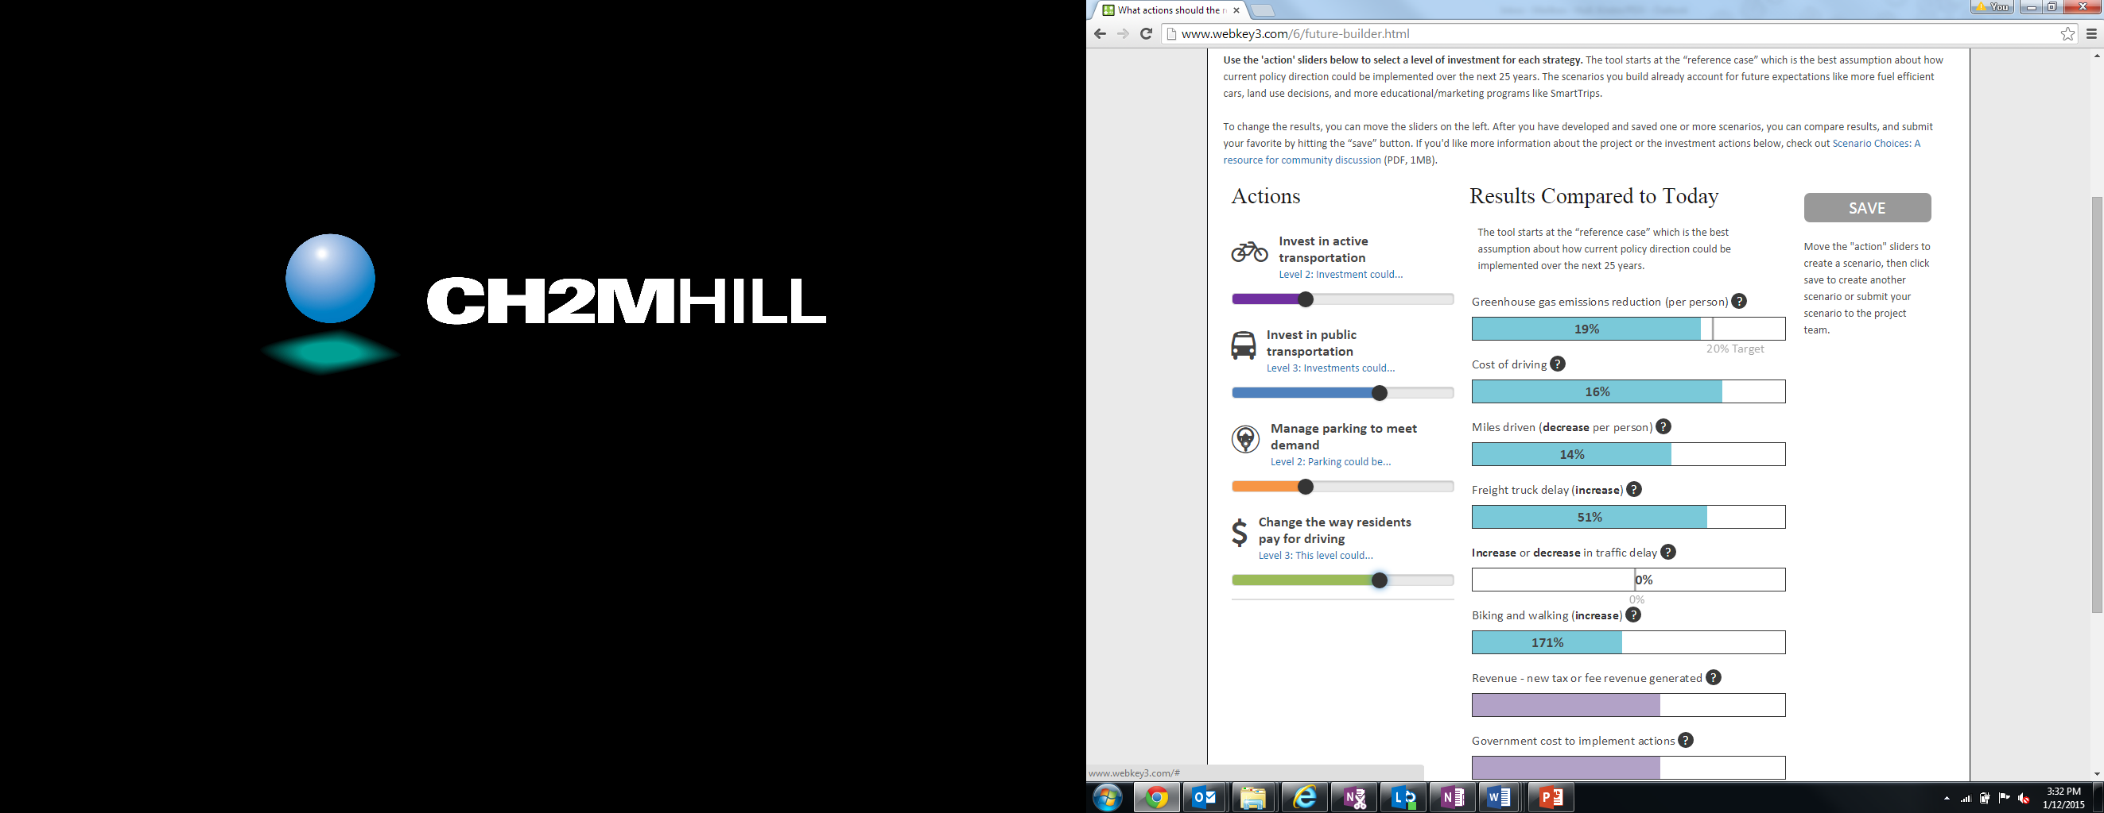
Outputs – Scenario Viewer
What will it take to meet our state climate goals?
Notes:
This is a more intuitive way to use the 100s of scenarios for policy makers and the public. It provides users an interactive method to see how different policy and investment actions result in different outcomes. It is even possible to set up the viewer for users to create and submit scenarios or policy levels that they prefer.

Slide 9
Questions?

